Slide 1

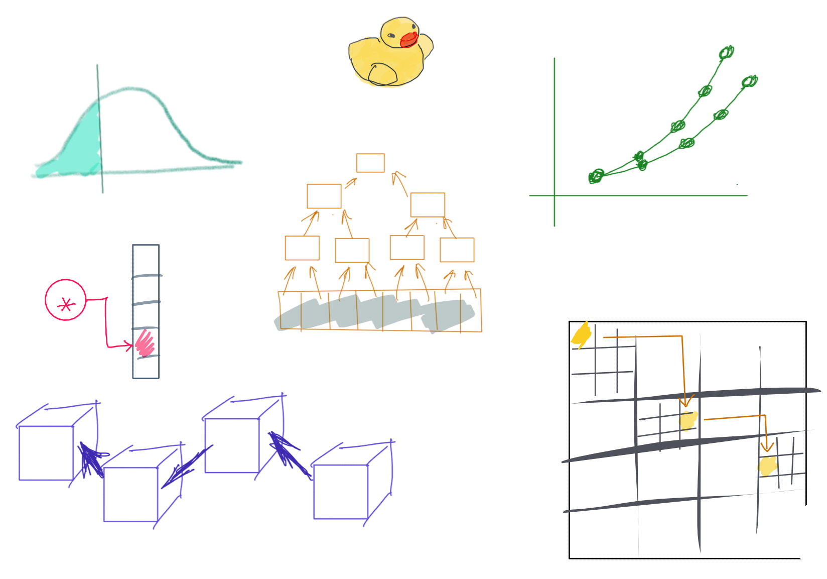

Slide 2
CSS342 Data Structures, Algorithms, and Discrete Mathematics (I)

Slide 3
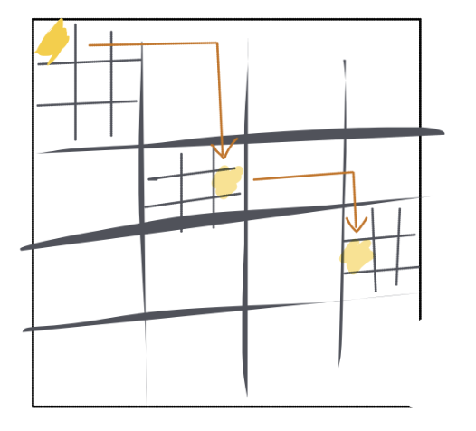
^{8th} Week Schedule
Midterm Review (Wed)
Homework 4 review (Wed)
Recursion practice
Quiz – 3, due next week
Percentile, Tree ADT (Friday)
Homework 5 to go live on Friday

Slide 4

Study Right

Slide 5
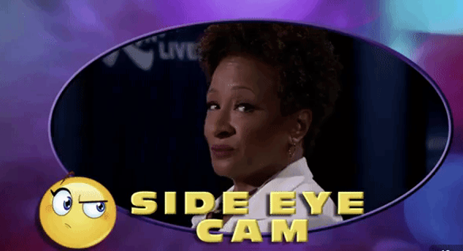
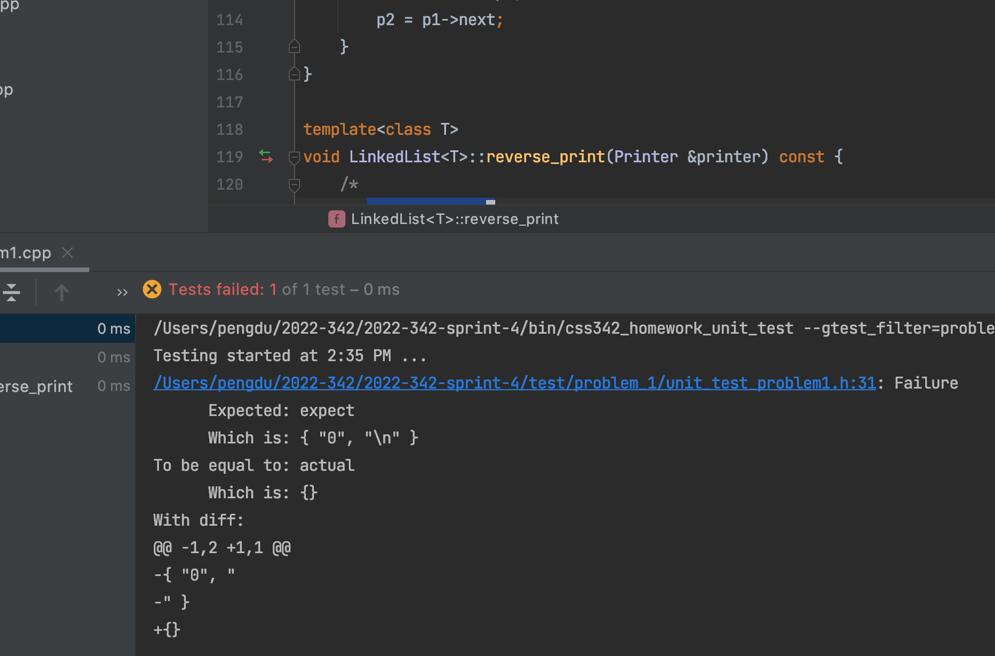
Ask The Right Question
“Professor. My test is failing. What’s wrong?”

Slide 6
Ask The Right Question
“My code doesn’t work.”
Which test case is failing?
What’s the specific error/failure?
What have your tried?
Breakpoint?
stackoverflow.com?
Google?

Slide 7
Ask the Right Question
“my code is failing with test case # ….
The specific error is …
I have checked … and ….”
Compiler error
Test case log
Code Logic
Debugger (breakpoint, stepping)
Memory issue (Linux)
Just google the damn error message!

Slide 8
Study Priority
Lecture PPT
Homework Code
Your code
Given code, e.g. tests
C++
Textbook
In-lecture demo
Code-along
Example code
Your technical debt items

Slide 9
Study Priority For Exams
C++
Sample Exam
Textbook
Code-along
Homework Code
Your code
Provided solution
Your technical debt items

Slide 10
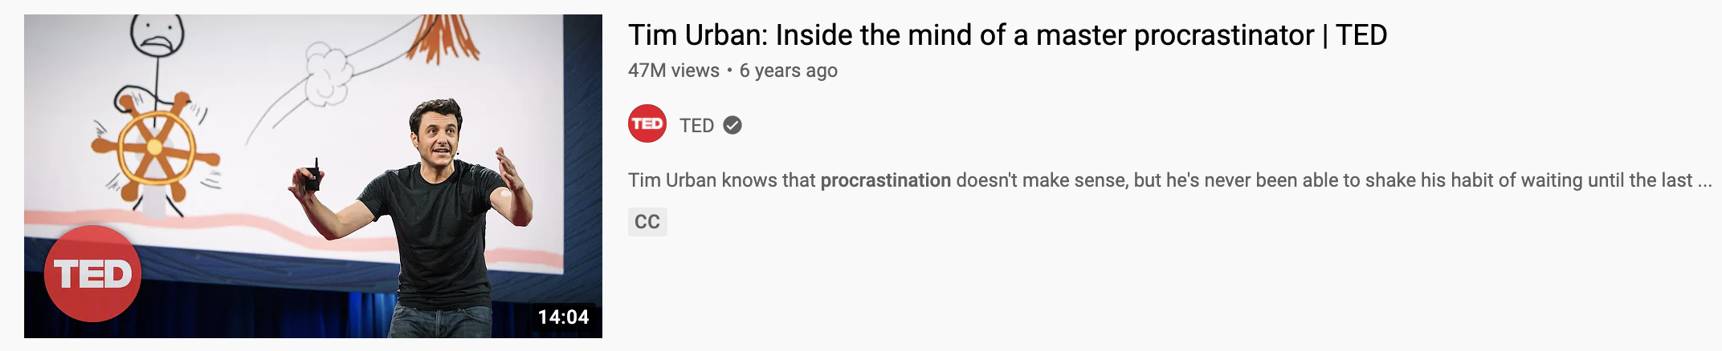
Beat Parkinson’s law
LINK
Have a plan
Have an estimate
Keep track of how long it takes for you to do a homework
Baby steps
Low hanging fruits
Fork, clone, new branch and PR
Compile code
Run tests

Slide 11
The “NOT MY FAULT” mindset
“What will I do differently if I can’t change what others do?”
Self-evaluation feedback loop

Slide 12
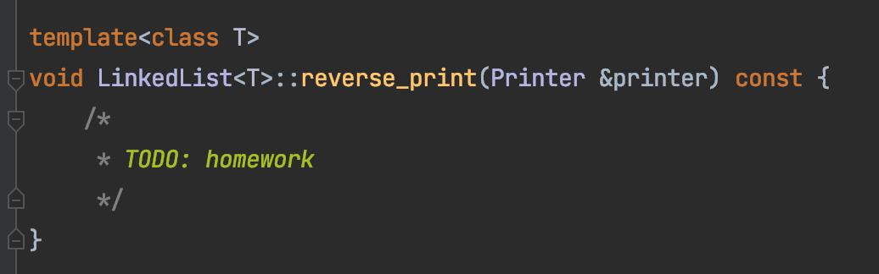
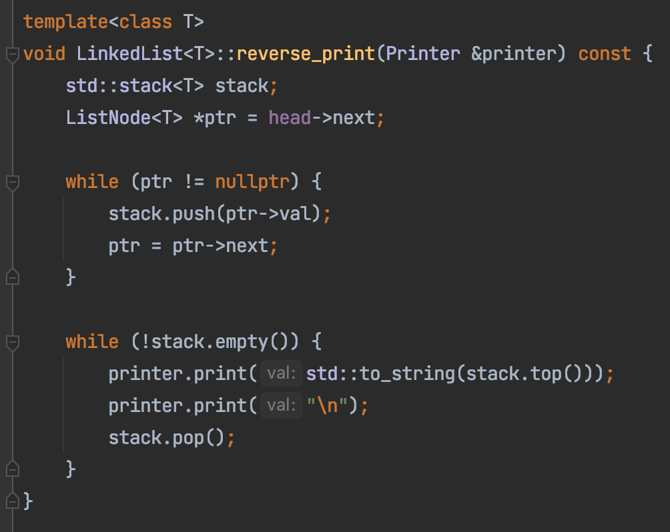
Homework 4 – Task 1
h
1
2
3
4
n
Create a stack
Traverse the list front to end, push each element onto a stack
Loop till the stack is empty,
Pop out every element from the stop
print the element

Slide 13
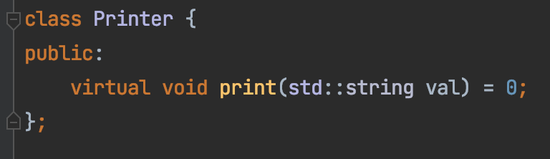
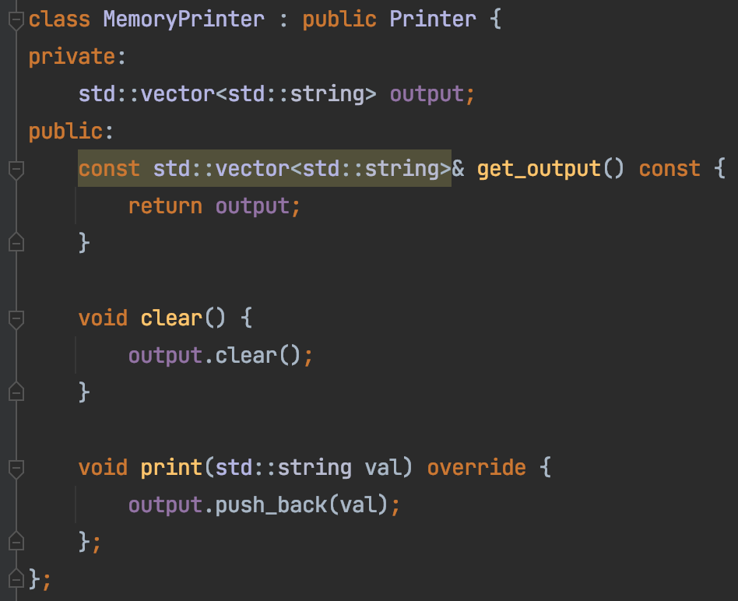

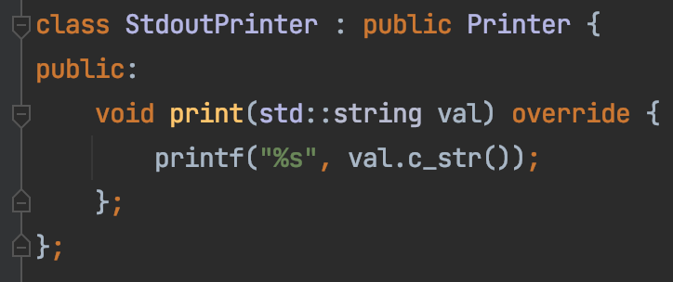
Homework 4 – Task 1
Decouple our code from how print is done
Interface
Implementation – For real use
Implementation – For testing

Slide 14
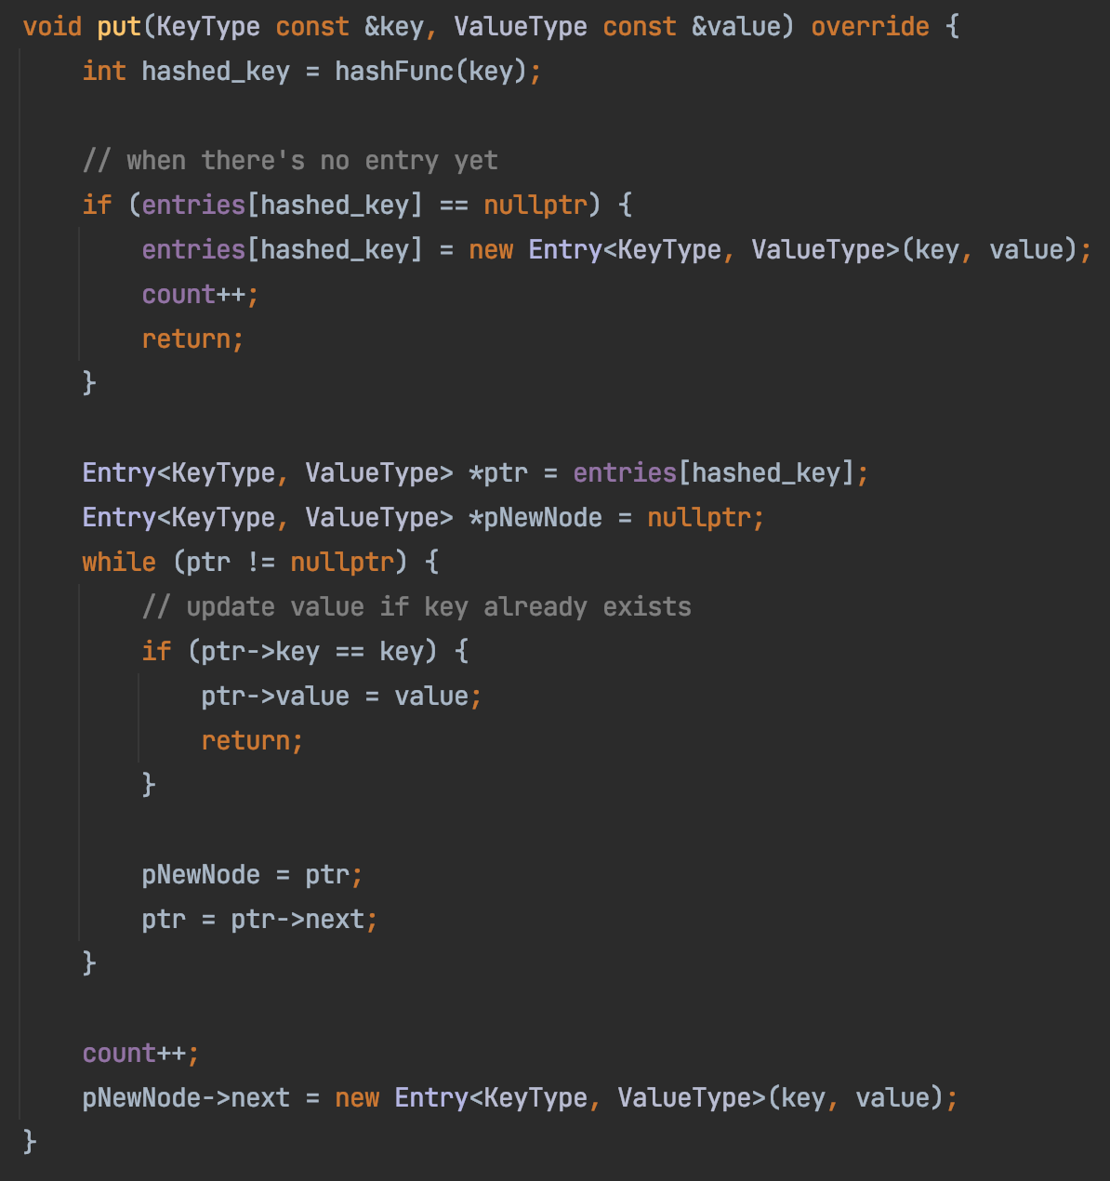
Homework 4
Tom
ArrayMap
Sam
Ron
Alex
Jerry
Joe
Tim
Hank

Slide 15
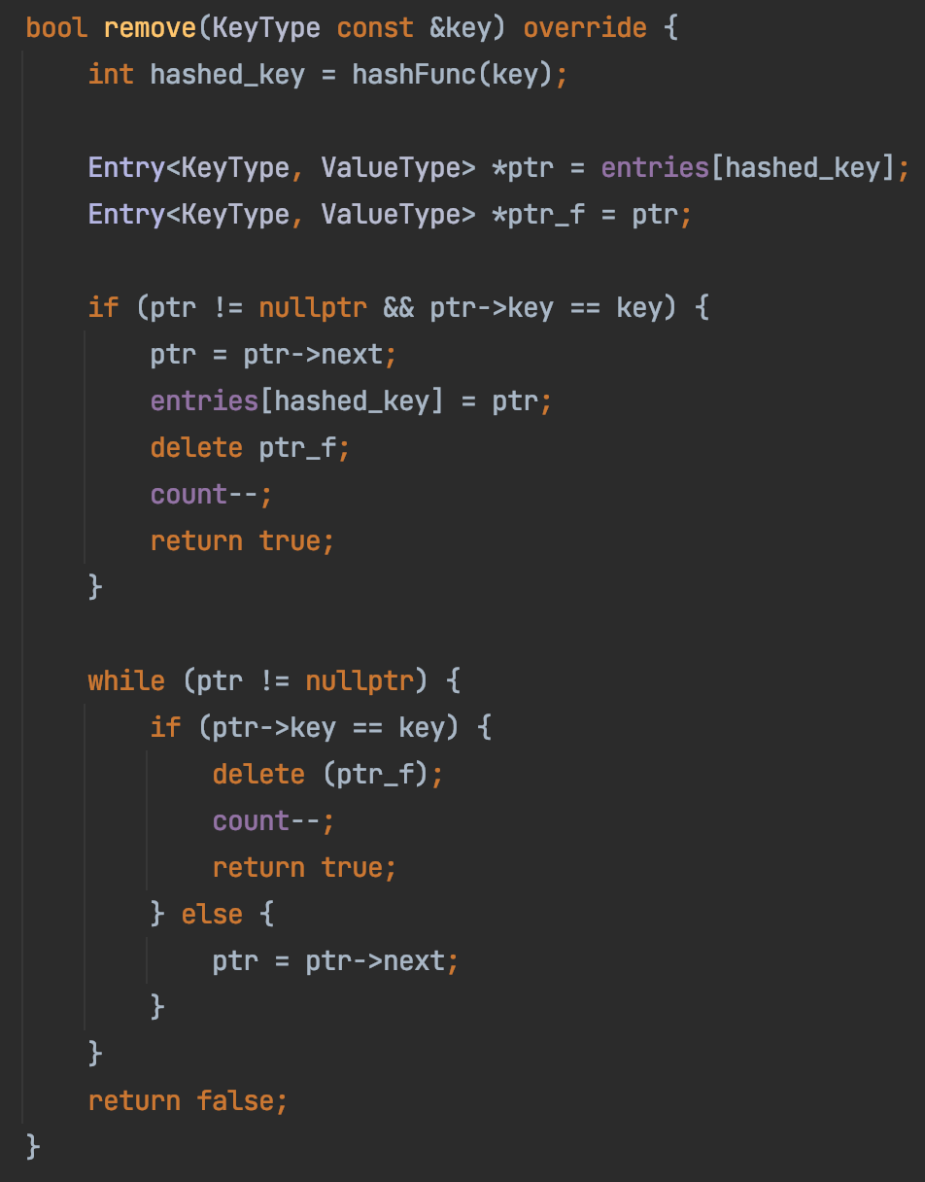
Homework 4
ArrayMap
Sam
Ron
Alex
Jerry
Joe
Tim
Hank

Slide 16
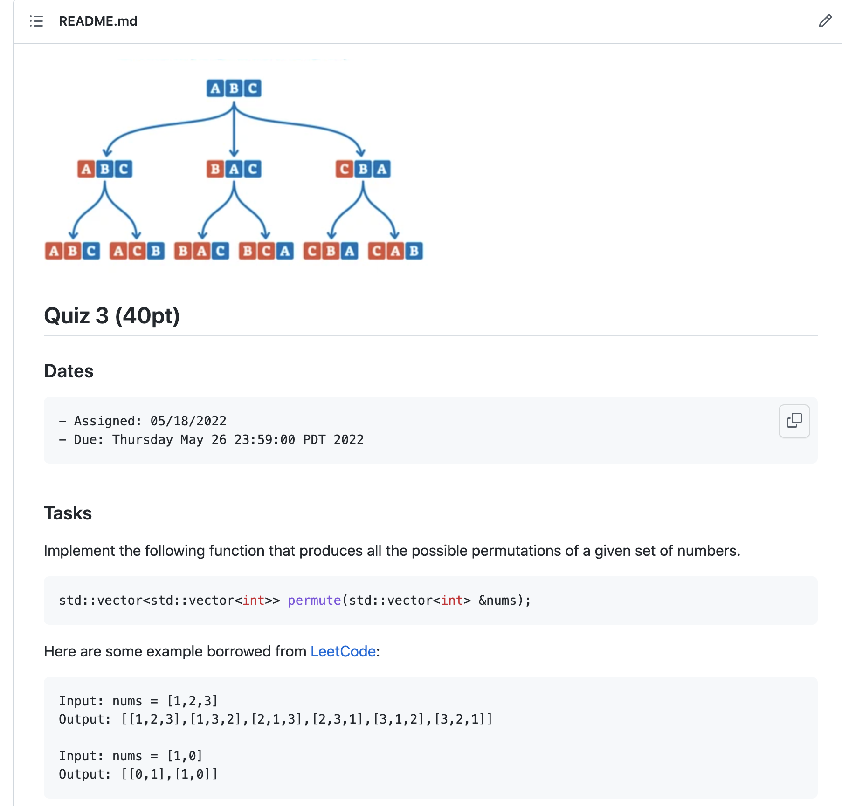
In-class Practice & Quiz-3
Based on https://leetcode.com/problems/permutations

Slide 17
1
1
1
2
1
2
2
1

Slide 18
2
3
1
3
2
1
3
2
1
2
3
3
1
1
2
3
2
1

Slide 19
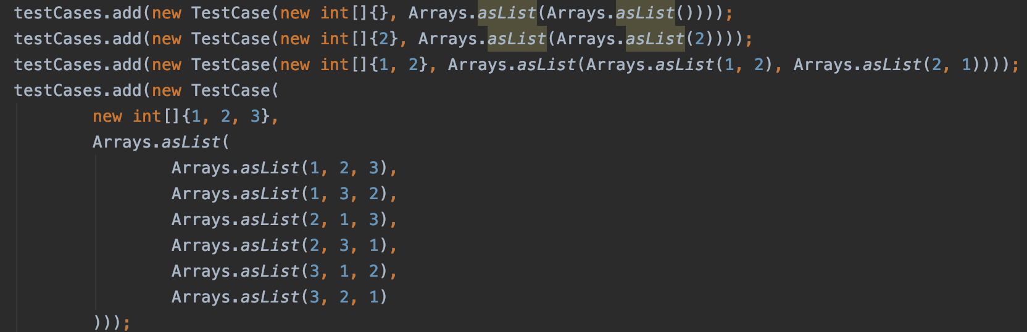

Slide 20




$$P([1])$$
1
1
1
2
$$P([2])$$
$$P([1,2])$$
1
2
2
1
$$P([1])$$

Slide 21
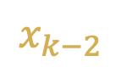


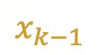
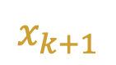
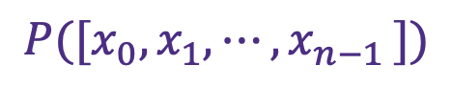
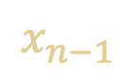

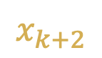
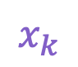
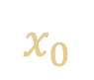
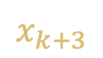
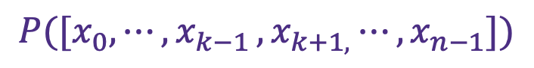


$$x_{0}$$
$$⋮$$
$$x_{k−3}$$
$$x_{k−2}$$
$$x_{k−1}$$
$$P([x_{0},x_{1},{⋯,x}_{n−1}])$$
$$=$$
$$x_{k}$$
$$,$$
$$P([x_{0},{⋯,x}_{k−1}{{,x}_{k+1,}⋯,x}_{n−1}])$$
$$x_{k+1}$$
$$x_{k+2}$$
$$x_{k+3}$$
$$⋮$$
$$x_{n−1}$$

Slide 22




2
3
1
$$P([2,3])$$
3
2
$$P([1,2,3])$$
1
3
2
1
2
3
$$P([1,3])$$
3
1
1
2
3
$$P([1,2])$$
2
1

Slide 23
Homework 5
How to represent 2D array?
“Column major” : stores column by column
0
1
2
N=2 rows
3
4
5
M=3 columns
0
3
1
4
2
5
Data at location column i, row j : array[j*N+i]

Slide 24
Homework 5
Write a function to generate all possible N pairs of balanced parentheses.
N=1 → { }
N=2 → { } { } { { } }
{ } { } { }
{ } { { } }
{ { } } { }
{ { } { } }
{ { { } } }
N=3 →

Slide 25
Homework 5
Write a function to generate all possible N pairs of balanced parentheses.
Balanced: number of open parenthesis >= number of close parenthesis
number of any parenthesis <= N
N=2
{ { _{(2,0)}
{ { } _{(2,1)}
{ { } } _{(2,2)}
{ _{(1,0)}
{ } _{(1,1)}
{ } { _{(2,1)}
{ } { } _{(2,2)}

Slide 26
Recursion Summary
Largest number in an array
Subproblem: size – 1 of the array, not efficient
Binary search
Subproblem: half of the array, efficient
Possible stairs / number of unique paths
Subproblem: not efficient
Chasing solution
N-queue
all unique paths
Sudoku solver
parentheses
Trial and error

Slide 27
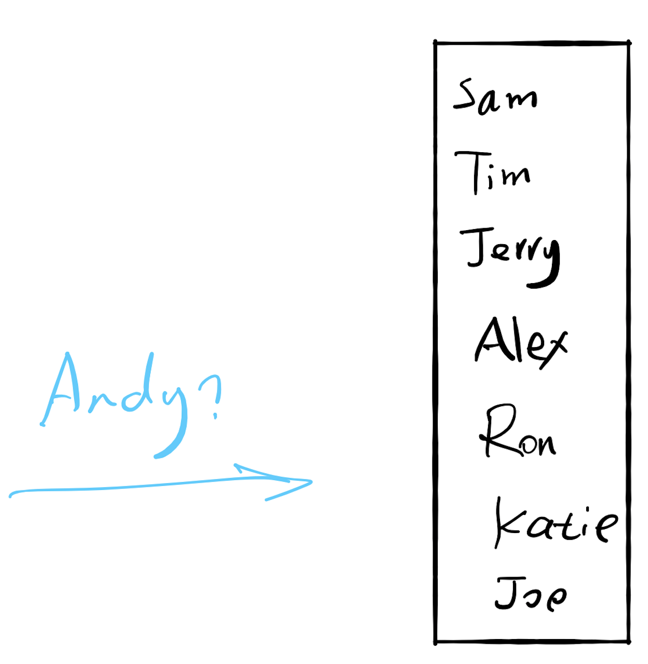

17.1 Search

Slide 28
If there are 10,000 users
Worst case: 10,000 seconds (2.8 hours)
Can we do better?
Sort

Slide 29
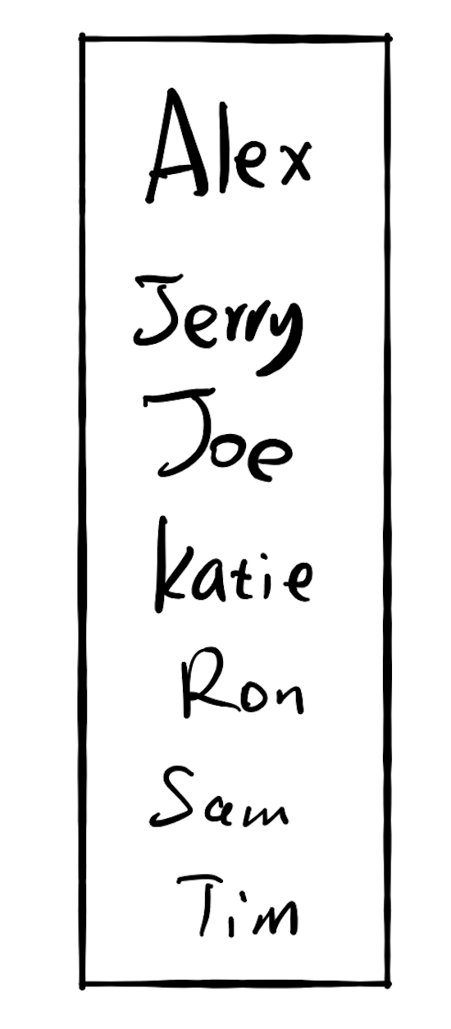
17.2 Insertion
If there are 10,000 users
Each memory ops takes 2 seconds

Slide 30
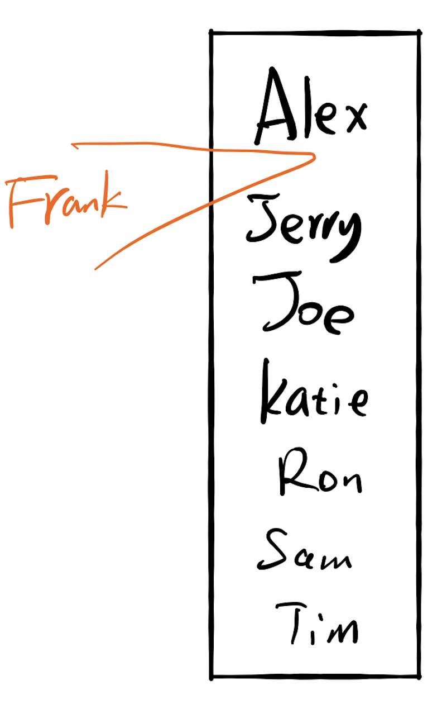
17.2 Insertion
If there are 10,000 users
Each memory ops takes 2 seconds
Search the location: 13.3 seconds
Insertion: $9,999 × 2 s$

Slide 31
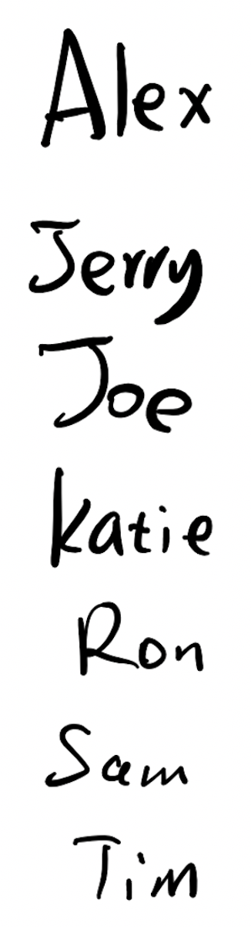

17.2 Insertion
If there are 10,000 users
Each comparison takes 1 seconds
Each memory ops takes 2 seconds
Insertion: $2s$
Search the location: ??

Slide 32
Fast for search
Slow for insertion
Slow for search
Fast for insertion

Slide 33
17.3 Do both fast?

Slide 34
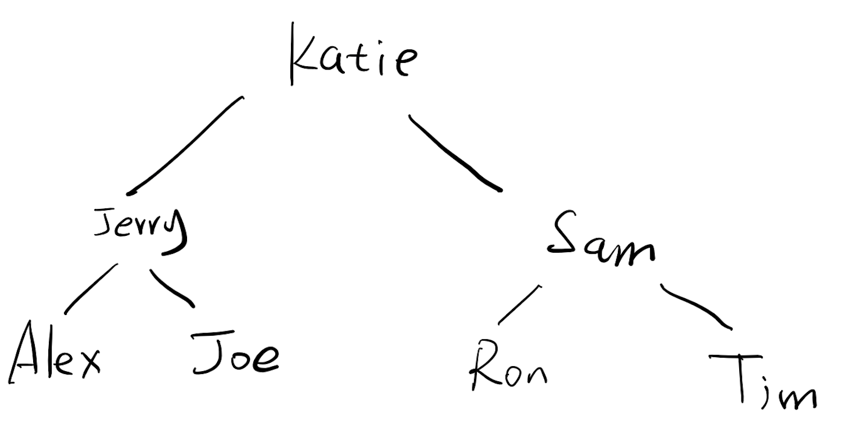

If there are 10,000 users
Each comparison takes 1 seconds
Each memory ops takes 2 seconds
Search the location:
13s
$$2s$$
Insertion:

Slide 35
A search problem
1
3
3
5
7
9
9
10
12
12
12
14
18
0
1
2
3
4
5
6
7
8
9
3
9
12
9
3
12
1
5
10
14
7
12
18

Slide 36
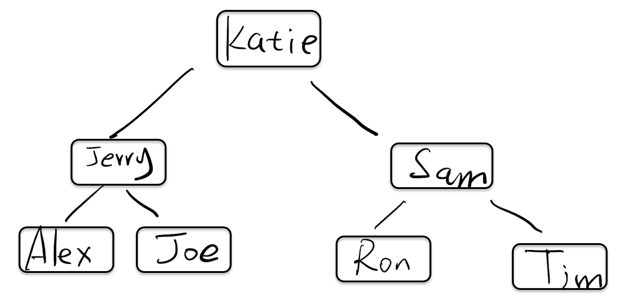
How do we implement this?

Slide 37
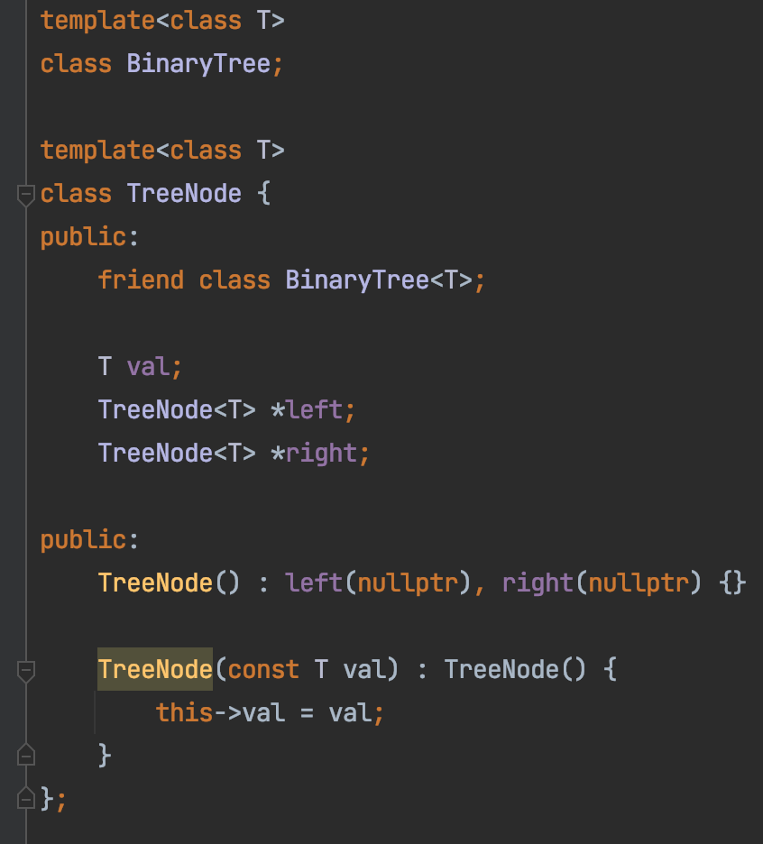

Slide 38
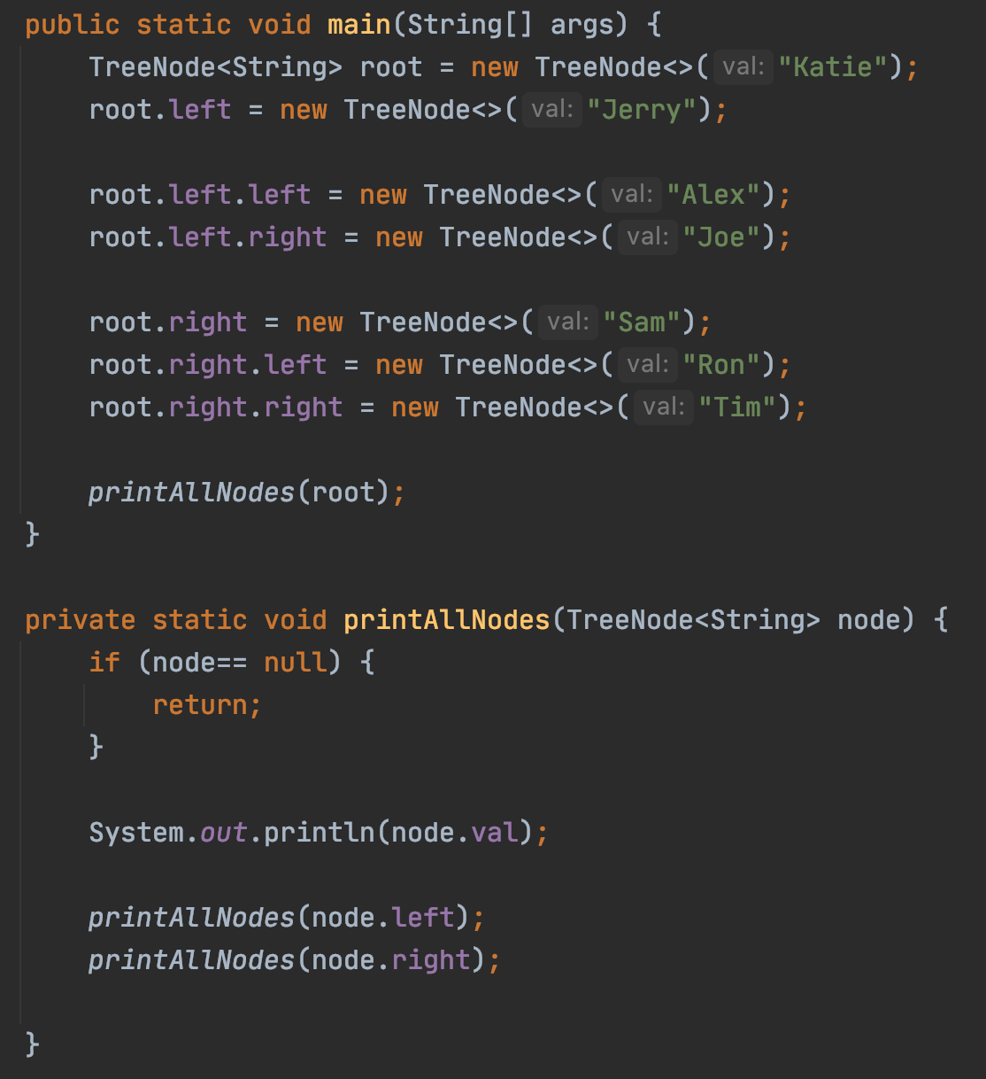
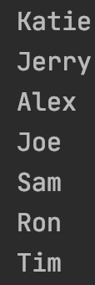

Slide 39
Binary Search Tree
A Binary Search Tree (BST) :
all the nodes follow the below-mentioned properties:
The left sub-tree of a node has a key less than or equal to its parent node's key.
The right sub-tree of a node has a key greater than to its parent node's key.

Slide 40
Exercise
Is this a binary search tree?
8
3
10
14
1
6
4
7

Slide 41
Exercise
Is this a binary search tree?
8
3
10
11
14
1
6
4
7

Slide 42
Exercise
Is this a binary search tree?
8
3
1
6
4
7

Slide 43
Exercise
Is this a binary search tree?
2
3
5
7
6
9

Slide 44

Demo
https://github.com/a-teaching-goose/2022-342-code-along/tree/2022-05-20

Slide 45
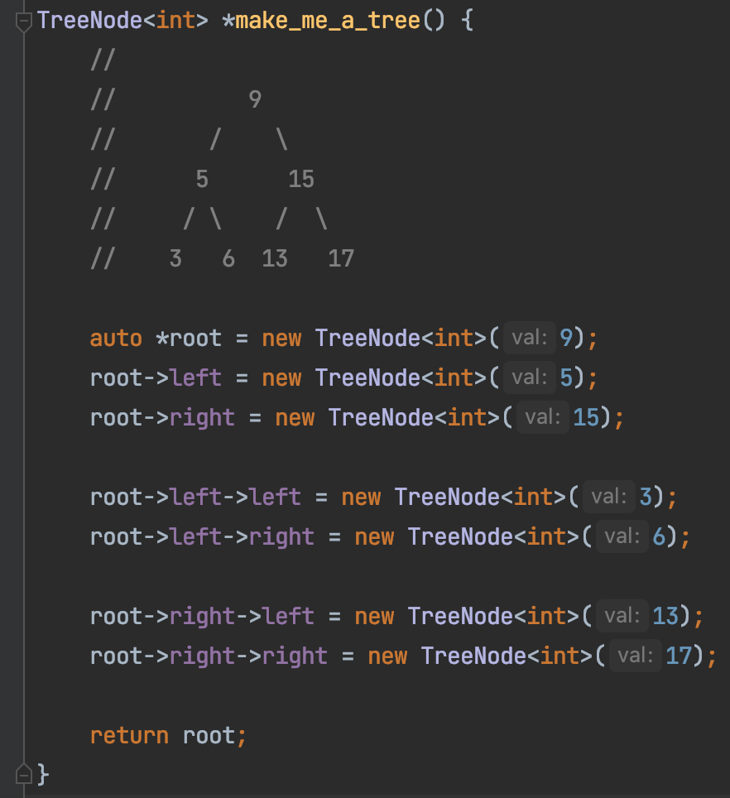
Build A BST

Slide 46
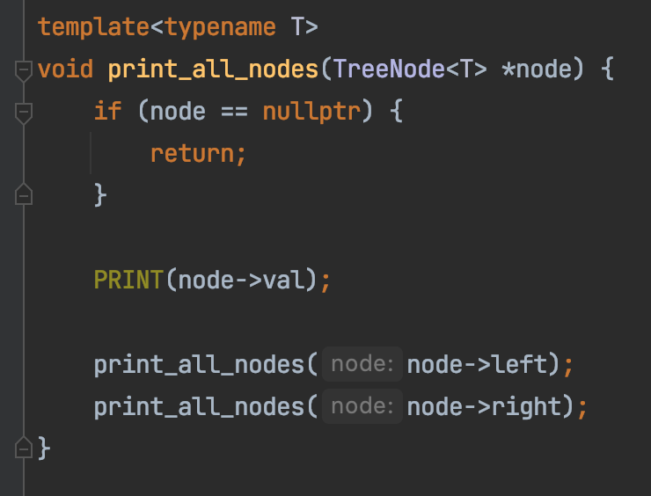
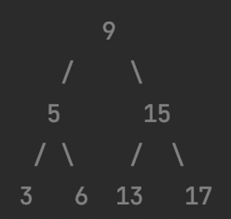
Print A BST

Slide 47
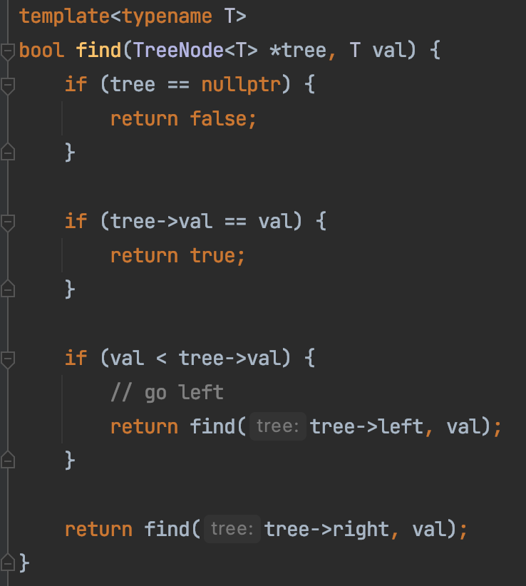
Search In A BST

Slide 48
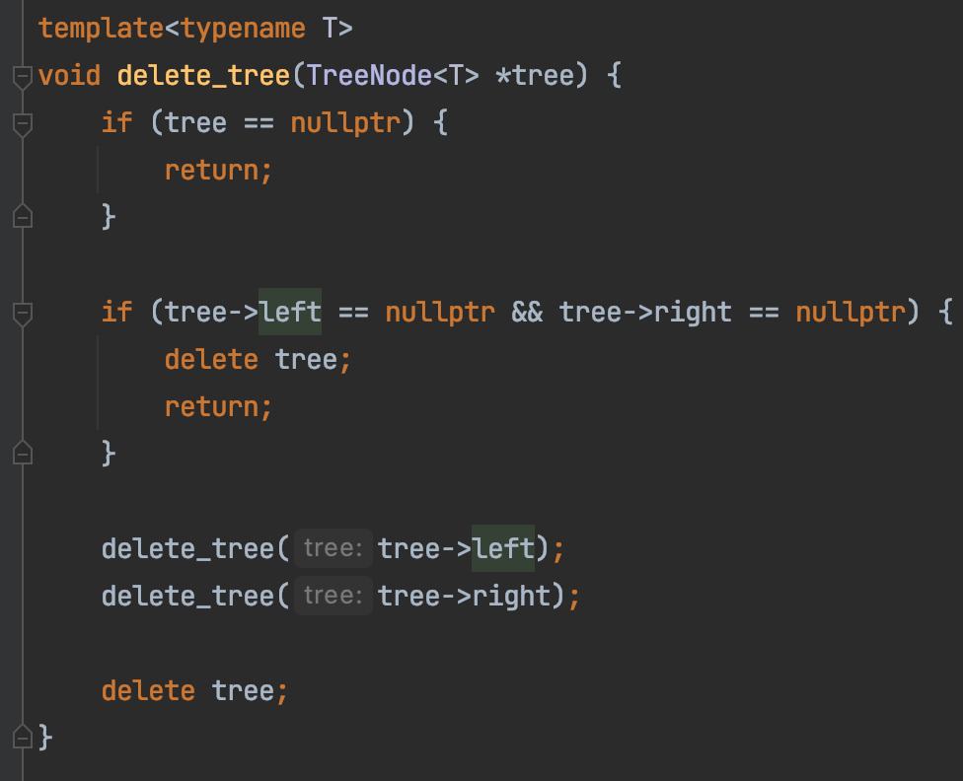
Delete A BST

Slide 49
Summary
Tree ADT
Faster Search than single linked list
Faster insertion/deletion than array
Faster range query than hashtable

Slide 50
LinkedList → Tree
Sam
Ron
Alex
Tom
Joe
Tim
Alex
Joe
Ron
Sam
Tom
Tim

Slide 51
Alex
Joe
Ron
Sam
Tom
Tim
Alex
Joe
Ron
Sam
Tim
Tom
Better worst case performance

